Slide 1
DOM

Slide 2
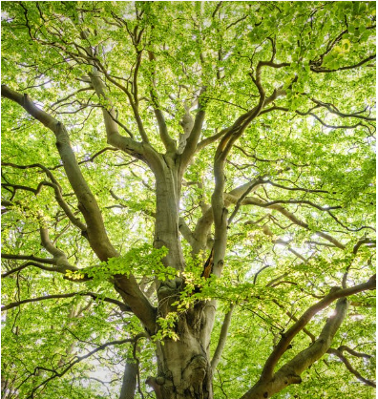
TREE DATA STRUCTURE

Slide 3
DESCRIPTION
A DATA STRUCTURE THAT CONSISTS OF NODES IN A PARENT/CHILD RELATIONSHIP.
Tree are non-linear ( many different path).

Slide 4
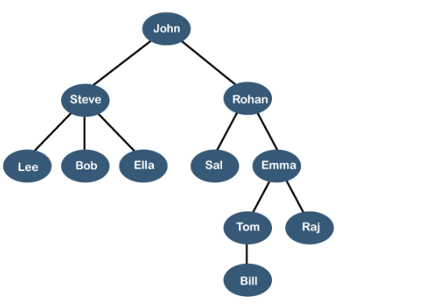
REAL TIME EXAMPLE LINKEDIN FRIENDS

Slide 5
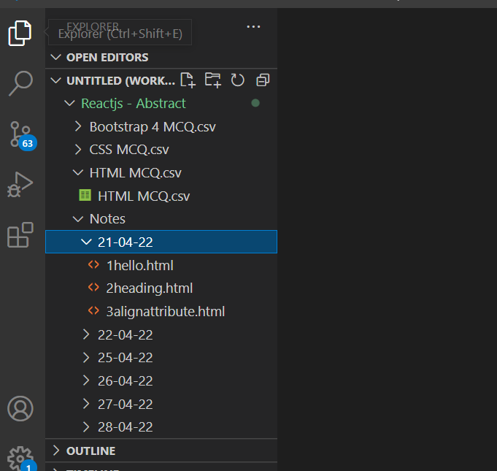
FILE SYSTEM

Slide 6
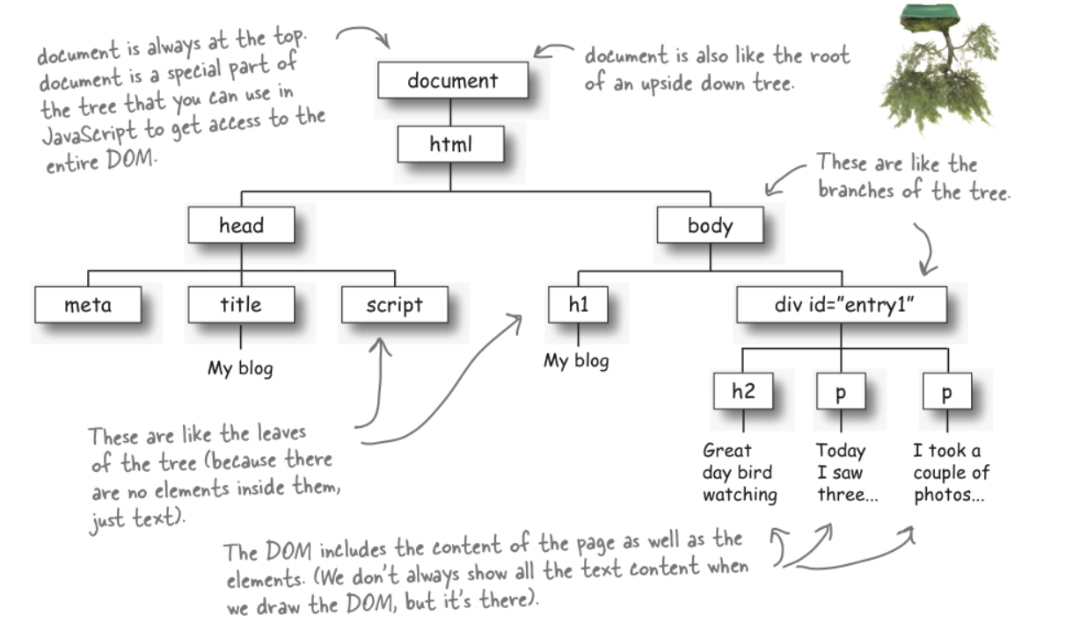
What is DOM ?
When a web page is loaded, the browser creates a Document Object Model of the page
The HTML DOM model is constructed as a tree of Objects:

Slide 7
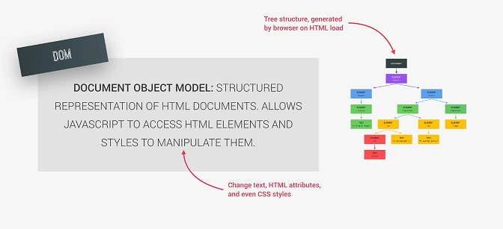

Slide 8
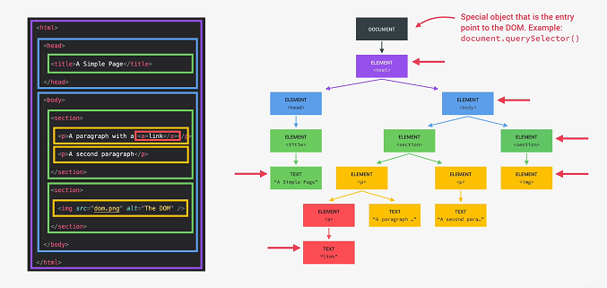

Slide 9
